Slide 1

Hunt for Luna 9
Challenge Design Team:
Cash Costello (REDD)
Jeff Plescia (SES)
Alicia Bargar (AOS)
Cash Costello
Chief, Intelligent Systems Center
ashley.llorens@jhuapl.edu

Slide 2
Introduction
In the 1960’s and 1970’s, the Soviet Union sent several unmanned probes to the moon.
In 2009, NASA launched the Lunar Reconnaissance Orbiter (LRO) to study the moon
We’ve found Luna 16 and Luna 20 (among others) in the LRO images
We haven’t found Luna 9 and 13

Slide 3
The Challenge
Create an algorithm to find Luna 9 and Luna 13
Starts June 17 and ends July 15
The challenge has 2 parts that run in parallel
Part 1
Training data of a Soviet sample and return lander (Luna 16)
Testing data of a Soviet sample and return lander (Luna 20)
Teams submit a ranked list of locations for automated evaluation
Monetary prize (SAA) to the best team

Slide 4
The Challenge
Create an algorithm to find Luna 9 and Luna 13
Starts June 17 and ends July 15
The challenge has 2 parts that run in parallel
Part 2
Testing data of a different Soviet lander (Luna 9 and Luna 13)
Teams submit individual locations for human review
Result for each location is Yes/No/Maybe
The LRO could be tasked based on Yes/Maybe locations
Any team that finds a lander is a winner and included in press release

Slide 5
Part 1
Website for creating teams, submitting results, viewing leaderboard (coming soon)
Go to http://isc
Each team can submit up to 10 times
A submission is a ranked list of image/location pairs
Submission must be from fully automated algorithm
Any location inside an 25 x 25 pixel bounding box centered on the ground truth location qualifies as a detection
The evaluation metric is average precision (approximation to area under the precision/recall curve)
The best score for each team is used on the leaderboard
The prize for the best team is $5,000
The winning team must provide the code used
The team with the most detections wins, tie breaker is average precision

Slide 6
Part 2
Each team can submit up to 5 distinct image/location pairs for human review
Submit through the website
Expected that there will be manual effort to select locations in addition to algorithms from Part 1
Feedback will be provided as the submissions are reviewed

Slide 7
Rules
Team Limits
There are no team size limits
External participants are allowed
External Data
Only the data provided on the competition website may be used (you can suggest additional data to be made available)
Prizes
$5,000 (SAA) to be shared by the first place team for Part 1 (APL staff members only)
Ties
A tie will be broken by submission order

Slide 8
Part 1 Submission Format
Tab separated file with 3 columns: image name, column index, row index (zero-based from top left corner)
The rows should be ranked from best to worst based on your algorithm
You will receive a score upon submission but will not get feedback on individual points
There will be minimum and maximum list lengths (still to be determined)

Slide 9
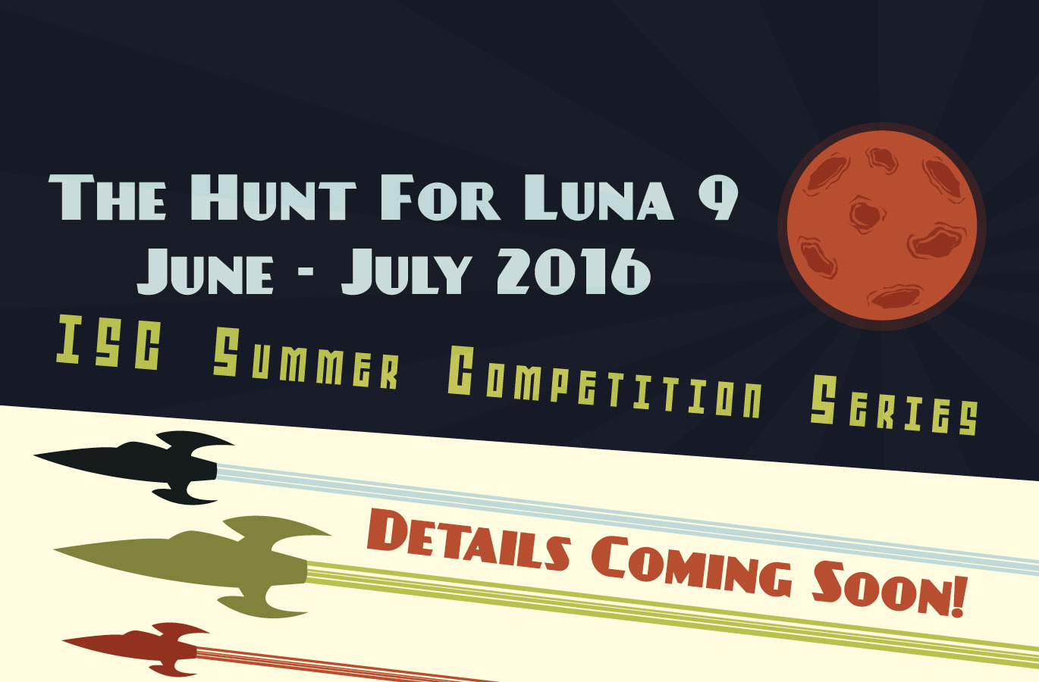

Slide 10
Image Processing Tools and Approaches
Hunt for Luna 9
Alicia Bargar
Associate Professional, QAS
Alicia.bargar@jhuapl.edu

Slide 11
Getting started
Some available tools:
Matlab
Image Processing Toolbox (provided!)
Computer Vision Toolbox
Python
OpenCV
Scikit-Image
C++
OpenCV (not recommended for hackathon)
This tutorial will be using Matlab
(utility code for Matlab and Python provided in appendix)

Slide 12
Matlab Installation
Request through APL website at http://softwareportal
Licensing information available at
https://aplweb.jhuapl.edu/services/Pages/MATLAB.aspx
Image Processing Toolbox available to all employees
Coming information about Computer Vision Toolbox

Slide 13
Python Installation
Linux or Windows
Python – download from https://www.python.org
Latest 2.7 version recommended
Tutorials at OpenCV-python mainpage here
Install Excel reader: pip install xlrd
For Mac
Open a new terminal window
Download Homebrew by running the following command:
/usr/bin/ruby -e "$(curl -fsSL https://raw.githubusercontent.com/Homebrew/install/master/install)”
Install python through homebrew
Brew install python
export PATH=/usr/local/bin:$PATH
source ~/.bash_profile
Install opencv through homebrew:
tap homebrew/science
brew install opencv
for parameter options – brew info opencv
Install Excel reader: pip install xlrd

Slide 14
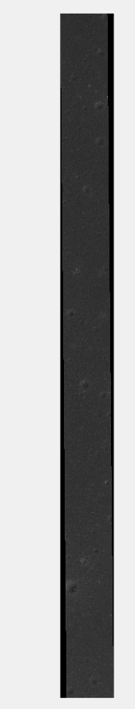
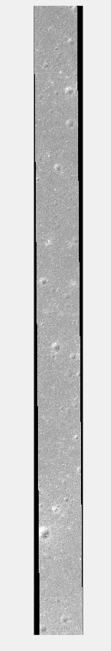
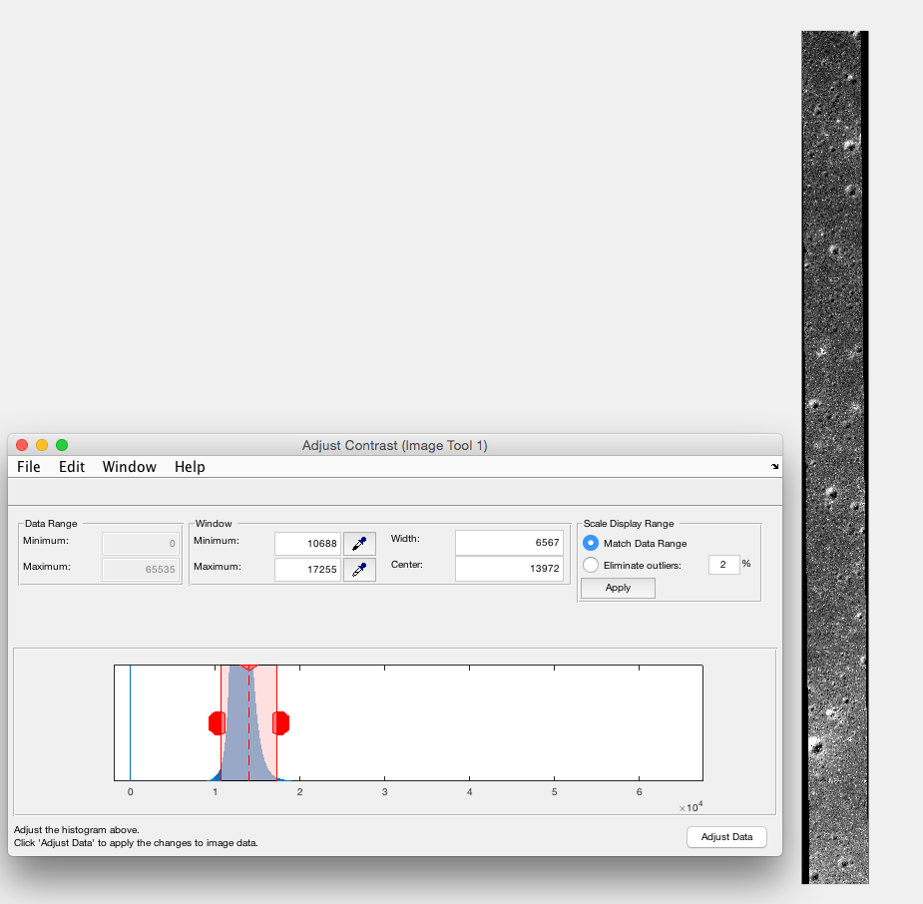
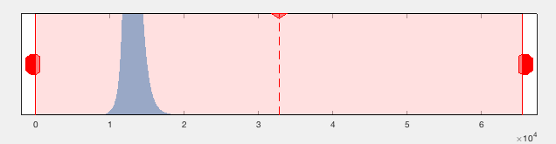
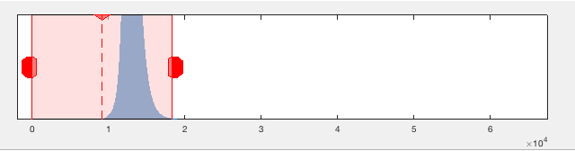
Working with 16bit Images
The benefits: access to far more information than typical
The challenge: humans can only visually see a small portion of the range at any given time.

Slide 15
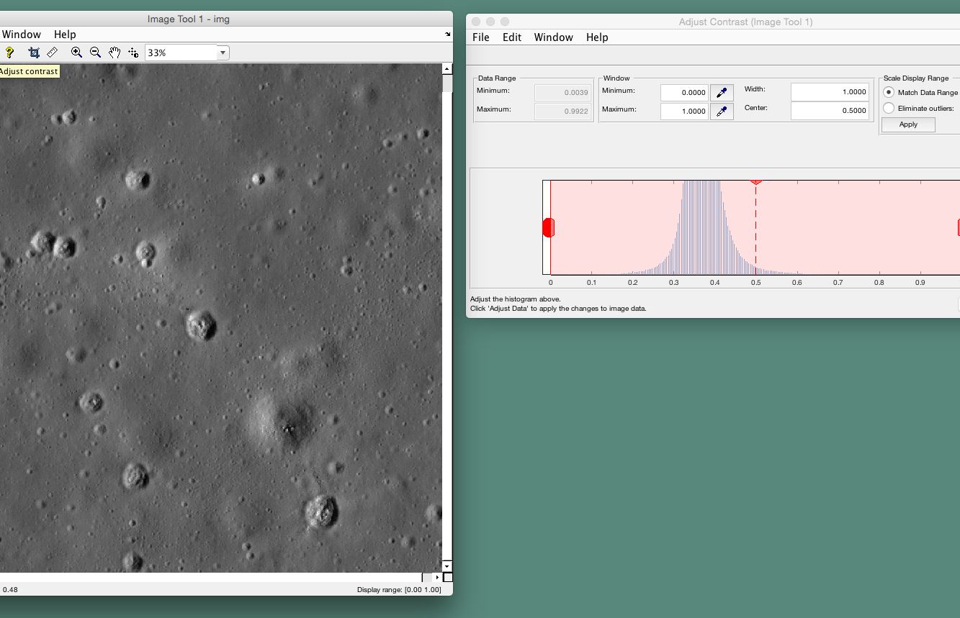
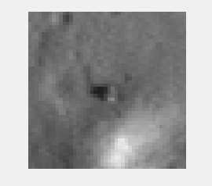
Using imtool to handle intensity range

Slide 16
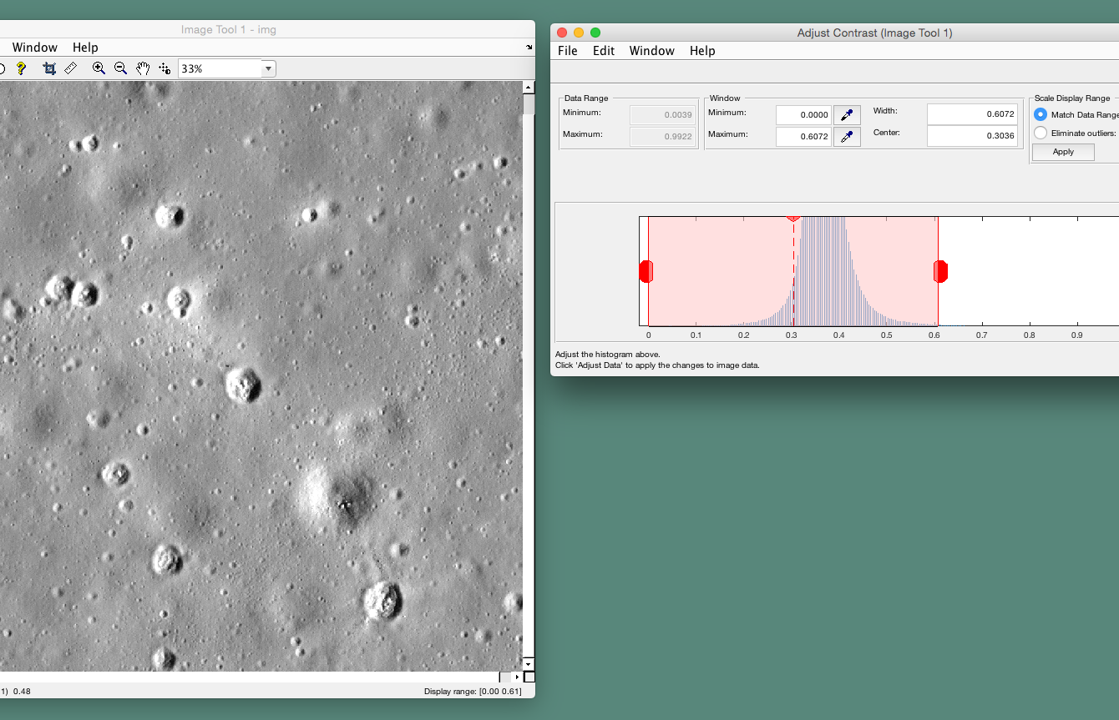
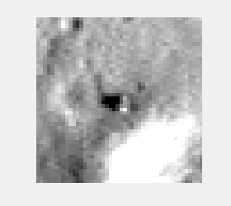
Example: Narrowing intensity range

Slide 17
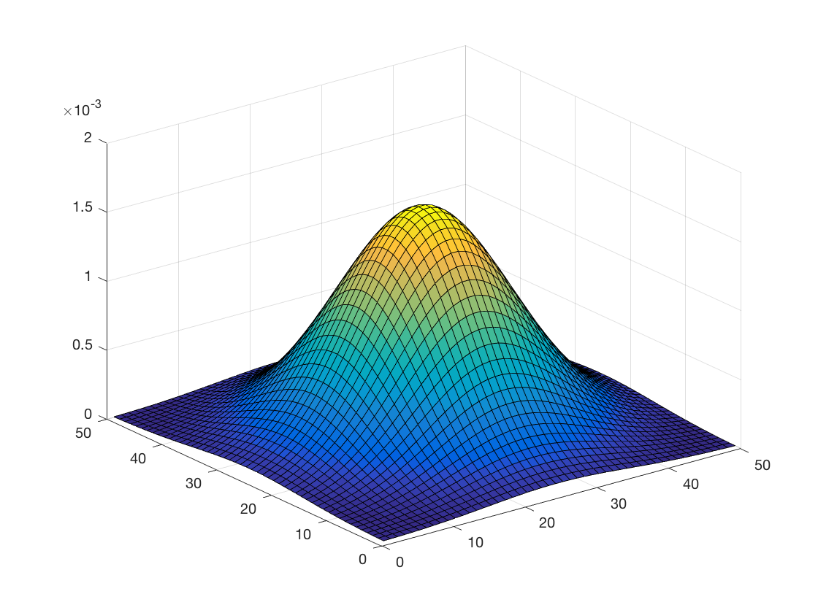
Example: Applying high pass filter
sigma = 10;
hsize = 50;
filter = fspecial('gaussian', hsize, sigma);
blurredimg = imfilter(img, filter);
detailimg = img - blurredimg;
%visualizing filter, see right
figure, surf(filter);
%normalizing result
detailimg = detailimg – min(detailimg(:));
Detailimg = detailimg / max(detailimg(:));
Notes:
*removing clutter

Slide 18
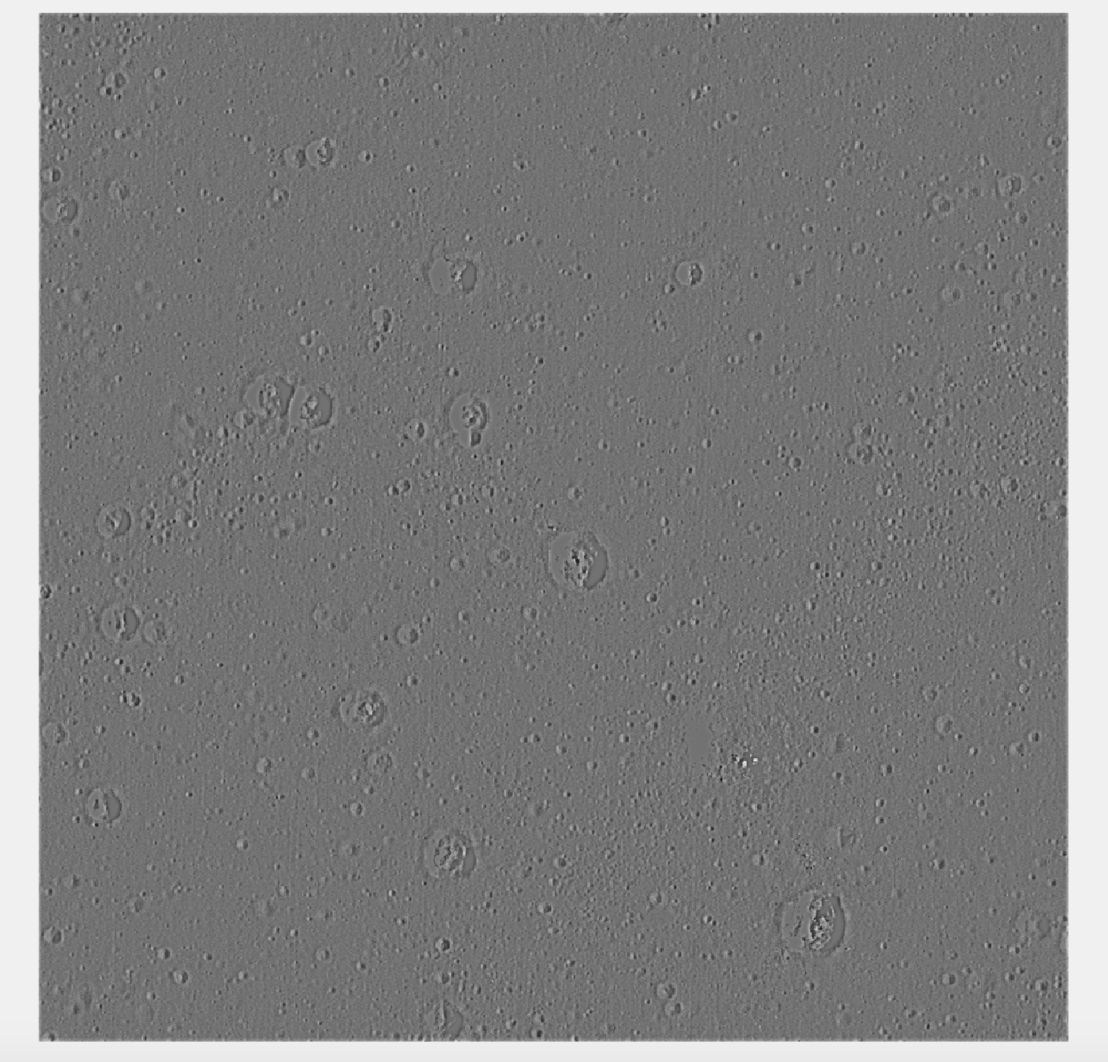
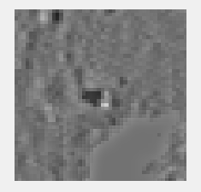
Example: Applying high pass filter

Slide 19
Sample Approaches: Morphological Operations
%dilation
se = offsetstrel('ball',2,6);
testDilated = imdilate(img, se)
figure('Name', 'Dilated'), imshow(testDilated);
%erosion
se = offsetstrel('ball',2,6);
testEroded = imerode(img, se)
figure('Name', ’Eroded'), imshow(testEroded);

Slide 20
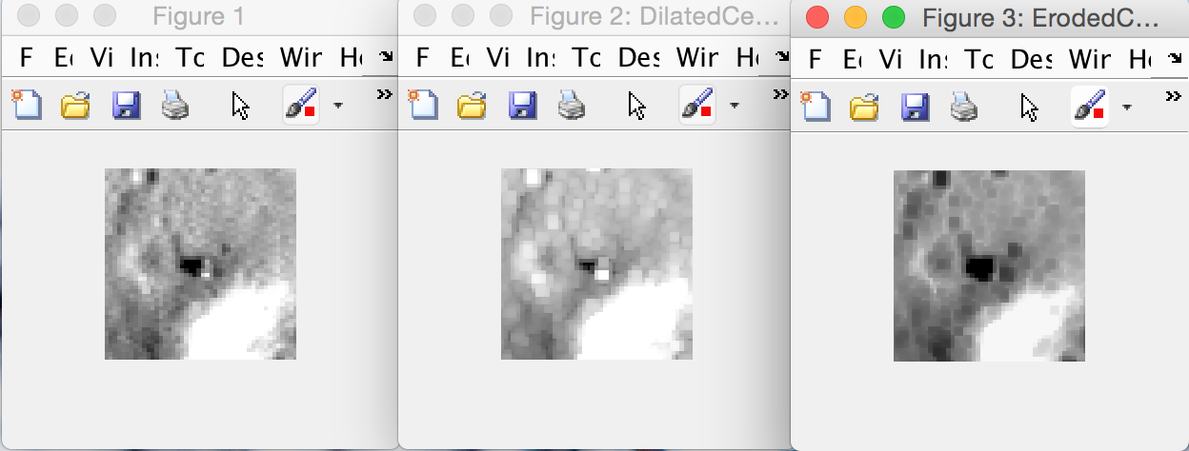
Morphological Operations
Original
Dilated
Eroded

Slide 21
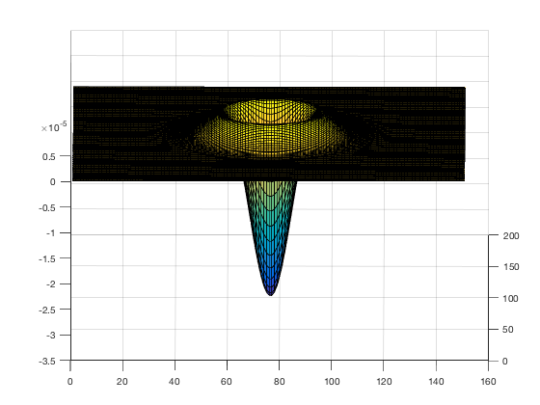
Sample Approaches: Template matching
%Creating template for albedo patches
laplacian = [0, 1, 0; 1, -4, 1; 0, 1 0];
sigma = 10;
k = 50;
G1=fspecial('gauss',[round(k*sigma), round(k*sigma)], sigma);
template = conv2(G1, laplacian);
surf(template);

Slide 22
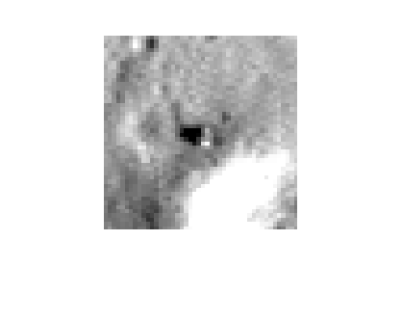
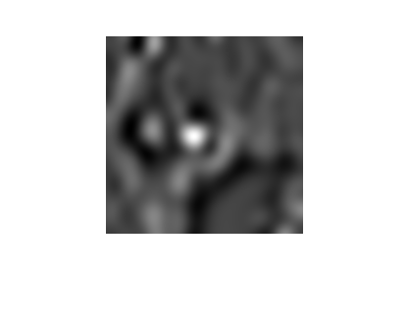
Template Matching
%padding to improve results at edges
padY = size(template,1);
padX = size(template,2);
paddedCenter = padarray(center, [padY padX], 'replicate');
result = imfilter(double(paddedCenter),template, 'corr');
result = result(padY+1:size(center,1)+ padY, padX+1:size(center,2) + padX);
imshow(result, [min(result(:)) max(result(:))]);

Slide 23
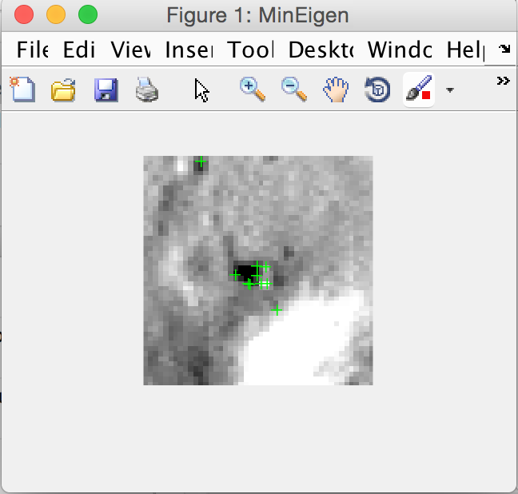
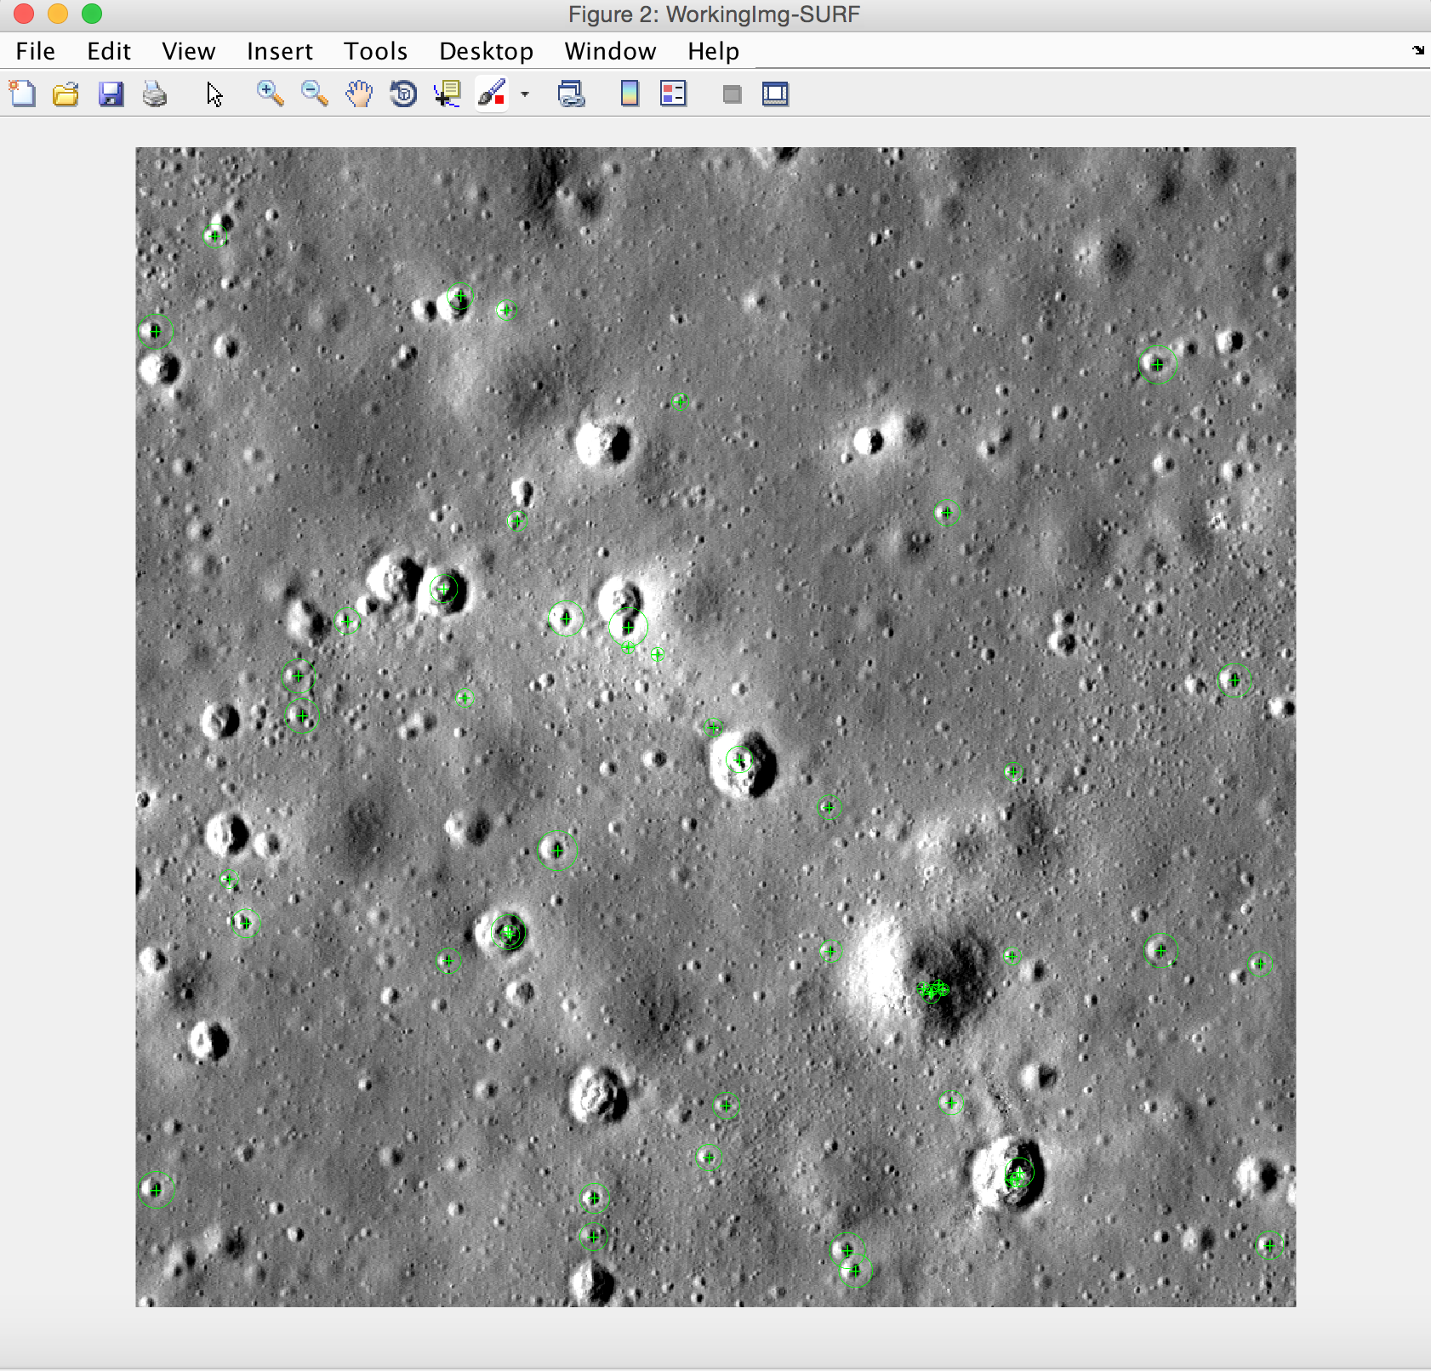
Sample approaches: Identifying features
%This is contained within the MATLAB Computer Vision toolbox
testBounded = imread('examples/narrowed_bands.png');
center = getCroppedCenter(testBounded,100);
%Harris corners
corners = detectMinEigenFeatures(testBounded);
figure('Name', 'MinEigen'), imshow(testBounded); hold on;
plot(corners.selectStrongest(50));

Slide 24
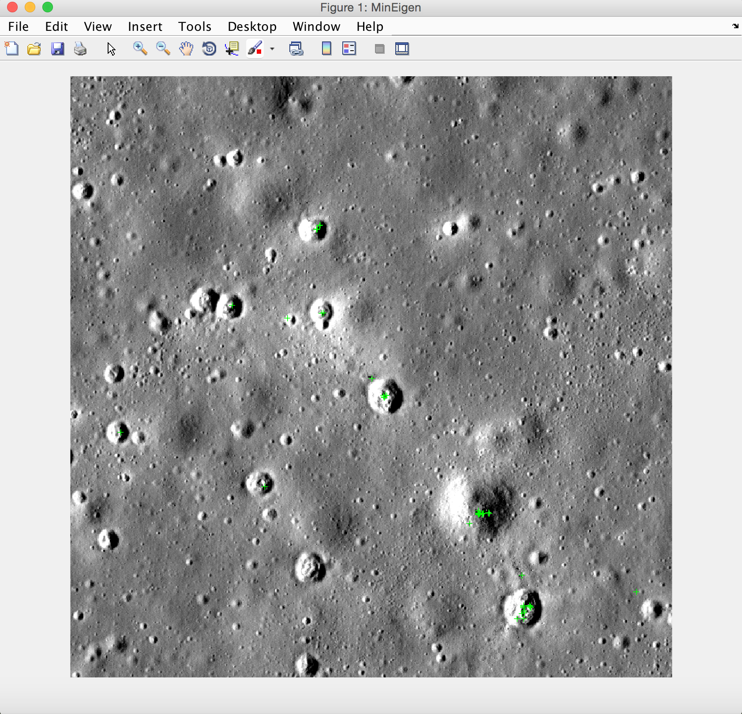
Sample approaches: Identifying features
%SURF features
points = detectSURFFeatures(testBounded);
figure('Name', 'WorkingImg-SURF'), imshow(testBounded);
hold on;
plot(points.selectStrongest(50));

Slide 25
Resources
Matlab Documentation (contains tutorials)
Image Processing Toolbox
Computer Vision Toolbox
OpenCV-Python Tutorials
Computer Vision Resources
http://www.computervisionmodels.com
Szeliski’s online book and resources

Slide 26
Appendix: Code Samples
Notes:
Include view image here

Slide 27
Opening and showing an image- Python
import cv2
img = cv2.imread(‘data/lunar.tiff’)
cv2.imshow(“Original”,img)
#following code needed to escape
k = cv2.waitKey(0)
if k == 27: #ESC key
cv2.destroyAllWindows()
Notes:
Include view image here

Slide 28
Read in metadata (excel) – MATLAB
Image | Scale
test1.tiff | 0.5
test2.tiff | 0.3
test3.tiff | 1.0
[num, txt, raw] = xlsread(‘demo.xlsx’);
%what each variable contains
num
num =
0.5000
0.3000
1.0000
txt
txt =
'test1.tiff'
'test2.tiff'
'test3.tiff’
raw
raw =
'test1.tiff' [0.5000]
'test2.tiff' [0.3000]
'test3.tiff' [ 1]

Slide 29
Read in metadata (excel) – PYTHON
Image | Scale
test1.tiff | 0.5
test2.tiff | 0.3
test3.tiff | 1.0
from xlrd import open_workbook
wb = open_workbook(‘demo.xlsx’)
for s in wb.sheets():
for row in range(s.nrows):
rowvals = []
for col in range(s.ncols):
rowvals.append(str(s.cell(row,col).value))
values.append(rowvals)
print values
[['test1.tiff', '0.5'], ['test1.tiff', '0.5'],
['test2.tiff', '0.3'], ['test3.tiff', '1.0']]
Notes:
Messy but that’s straight from xlrd tutorial

Slide 30
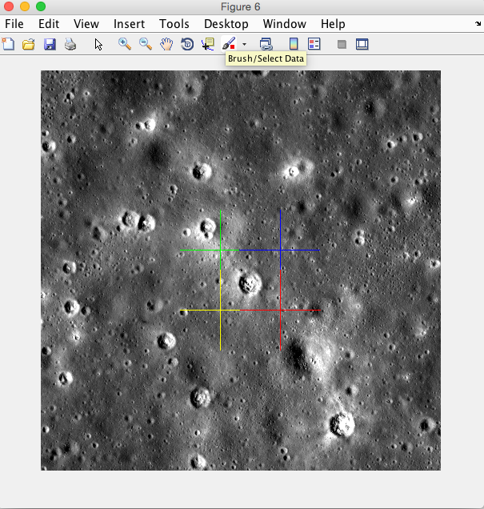
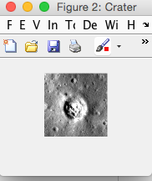
Crop region-MATLAB
top = 450;
bottom = 600;
left = 450;
right = 600;
%show cropped region
rgb = img(:,:,[1 1 1]);
figure, imshow(rgb);
hold on;
plot(left,top,'g+','MarkerSize',100);
plot(right,top,'b+','MarkerSize',100);
plot(left,bottom,'y+','MarkerSize',100);
plot(right,bottom,'r+','MarkerSize',100);
hold off;
%create and show cropped image
cropped = img(top:bottom,left:right);
Figure, imshow(img);
Figure(‘Name’, ‘Cropped’), imshow(cropped);

Slide 31
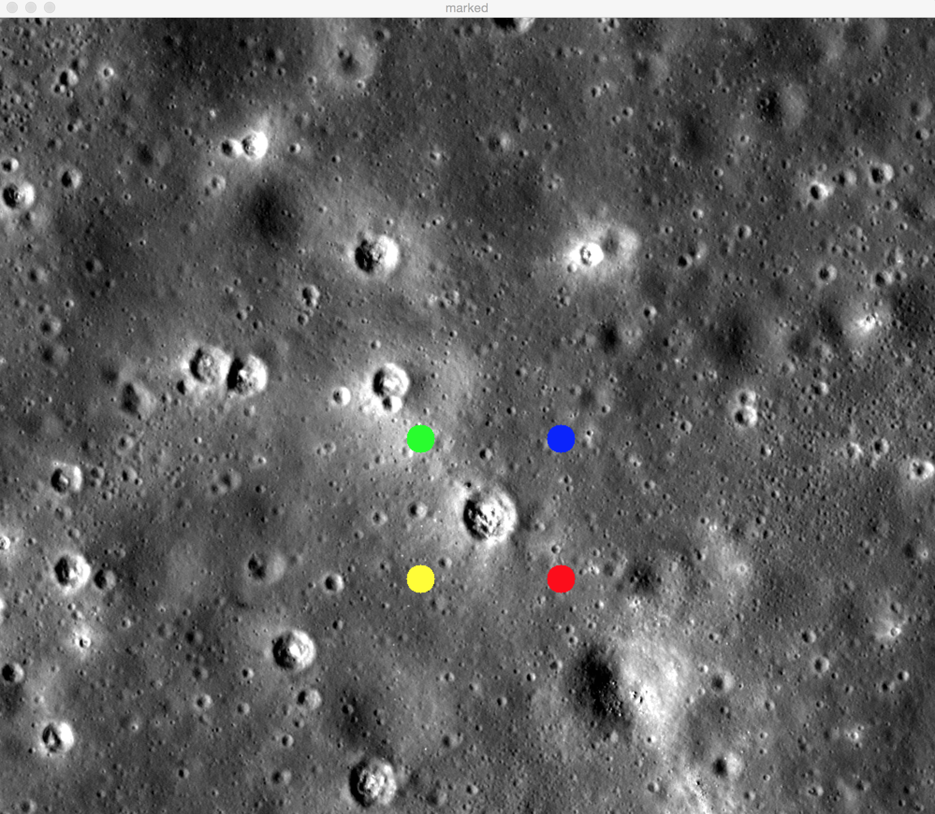
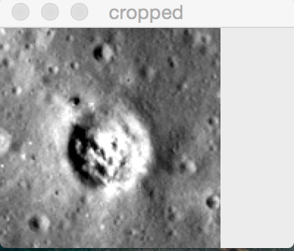
Crop region-PYTHON
top = 450
bottom = 600
left = 450
right = 600
#show cropped region
clone = img.copy()
cv2.circle(clone, (left,top), 15, (0,255,0),-1)
cv2.circle(clone, (right,top), 15, (255,0,0),-1)
cv2.circle(clone, (left,bottom), 15, (0,255,255),-1)
cv2.circle(clone, (right,bottom), 15, (0,0,255),-1)
cv2.imshow('marked',clone)
#create and show cropped image
cropped = img[top:bottom,left:right]
cv2.imshow(“cropped”, cropped)

Slide 32
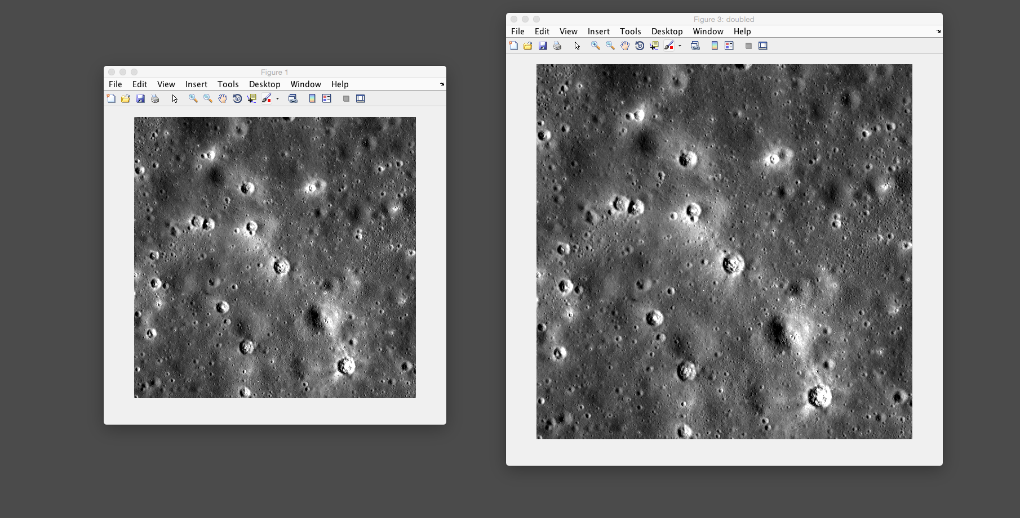
Resize and save image -MATLAB
%imgresized = imresize(img,ratio,method)
imgx2 = imresize(img,2,’nearest’);
Figure(‘Name’,’doubled’), imshow(imgx2);
imwrite(imgx2, ‘resizedImg.tif’);

Slide 33
Resize and save image -Python
dimx2 = (img.shape[0]*2, img.shape[1]*2)
imgx2 = cv2.resize(img, dimx2, interpolation = cv2.INTER_AREA)
cv2.imwrite("resizedImg.tiff", imgx2)

